Slide 1
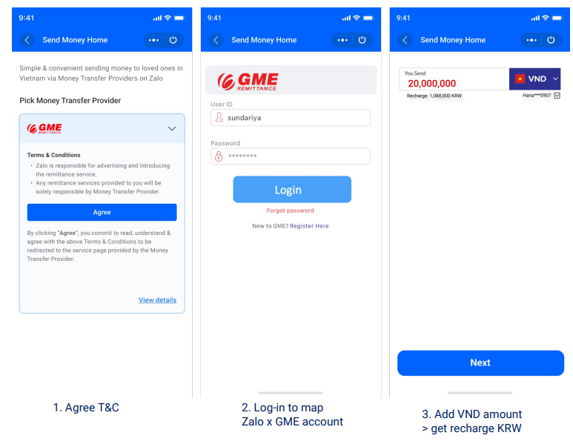
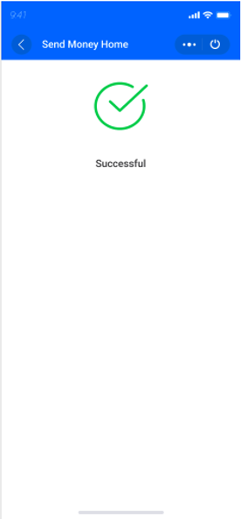
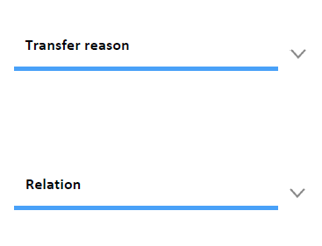
Sender Side: 1st time in Zalo -> 1st time receiver -> login within Zalo and add VND amount (1/2)
Transfer reason
Relation

Slide 2
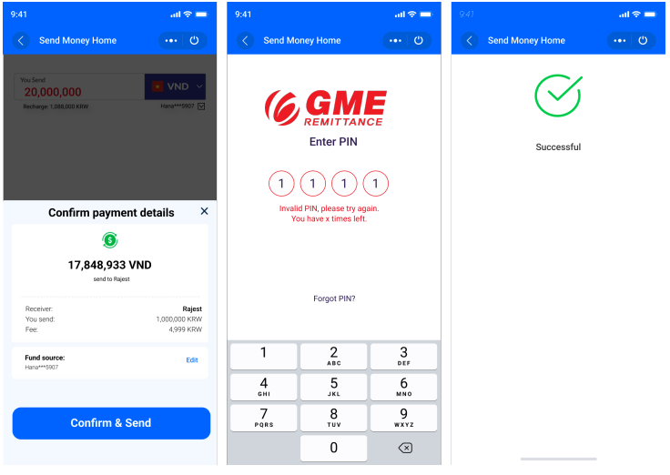
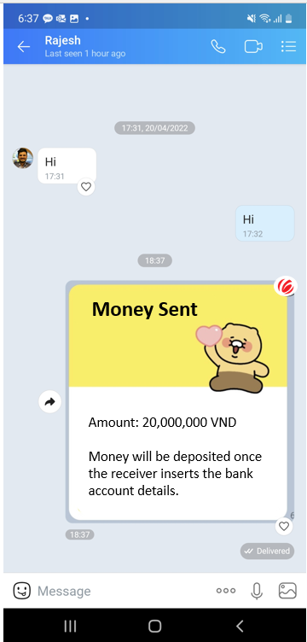

Sender Side: 1st time in Zalo -> 1st time receiver -> login within Zalo and add VND amount (2/2)

Slide 3
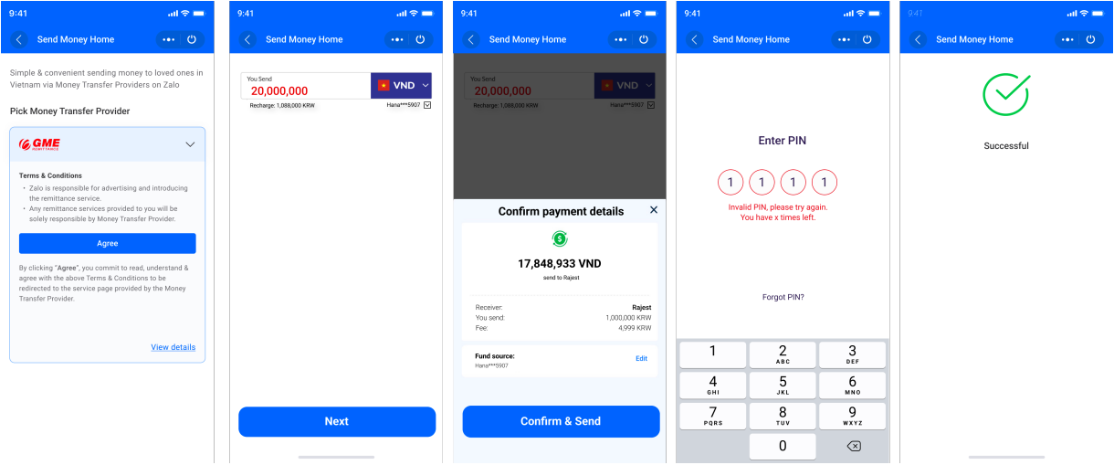
Sender Side: 2nd time in Zalo -> 2nd time receiver -> login within Zalo and add VND amount (1/1)

Slide 4
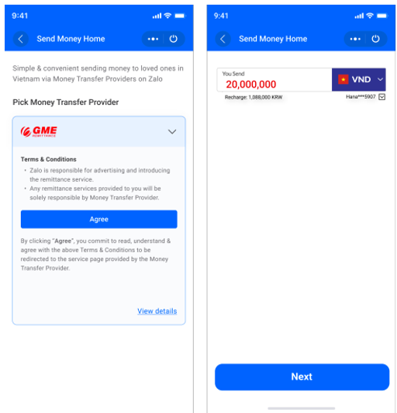
Sender Side: 3rd time in Zalo -> 1st time receiver -> login within Zalo and add VND amount (1/2)
Transfer reason
Relation

Slide 5

Sender Side: 3rd time in Zalo -> 1st time receiver -> login within Zalo and add VND amount (2/2)

Slide 6
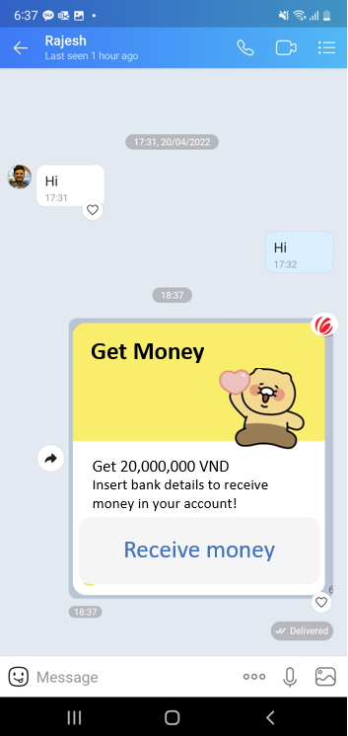
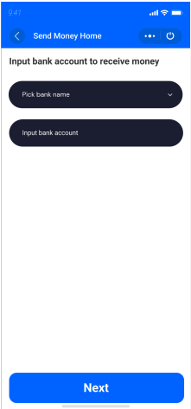

Receiver’s Side: 1st time receive in Zalo (1/2)
Input below details to receive money
City
Input your city
Address
Input your address
Phone number
Input your phone number

Slide 7
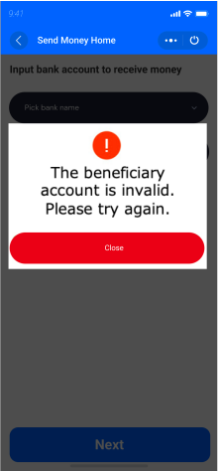
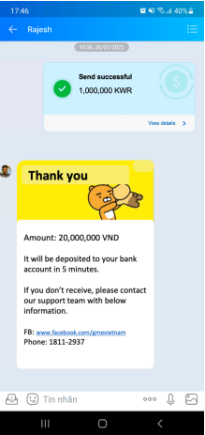

Receiver’s Side: 1st time receive in Zalo (2/2)
Bank name
Bank name
Bank name
Bank name
Pick bank name
Vietcombank
Bank account
Bank account
Bank account number
Bank account number
Input bank account number
****1234
Bank account owner - Name
Bank account owner - Name
Bank account holder: Name
Bank account holder: Name
---
RAJESH PAUDEL

Slide 8
Receiver’s Side: 2nd time receive in Zalo (1/1)
Bank name
Bank name
Vietcombank
Bank account
Bank account number
****1234
Bank account owner - Name
Bank account holder: Name
RAJESH PAUDEL

